Slide 1


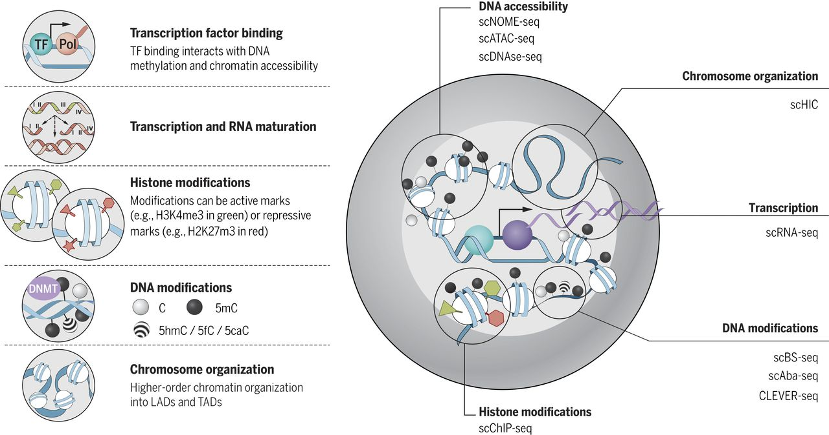



Artificial Neural Networks for MultiOmics Integration
Physalia course, 15-17 December 2025, University of Barcelona Nikolay Oskolkov, MRG Group Leader, LIOS, Riga, Latvia
@NikolayOskolkov
@oskolkov.bsky.social
Personal homepage: https://nikolay-oskolkov.com
Image adapted from Kelsey et al., Science 2017

Slide 2
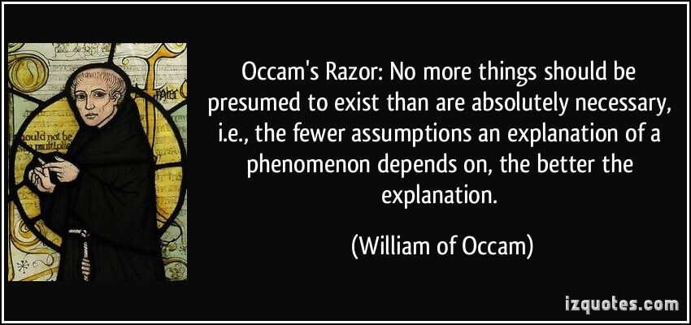
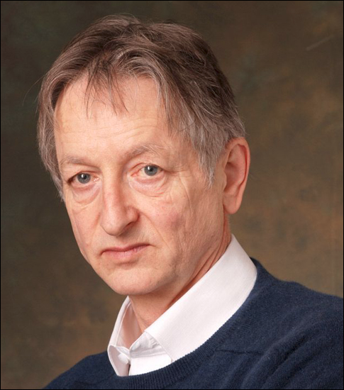
Challenges of Deep Learning in Life Sciences
Difficult to apply to real Life Science projects (NGS: tabular data)
Lack of data in Life Sciences (exceptions: single cell, microscopy)
Simpler (than Deep Learning) methods often perform better
Why don’t neural networks always work?
Geoffrey Hinton: Nobel prize in physics 2024

Slide 3
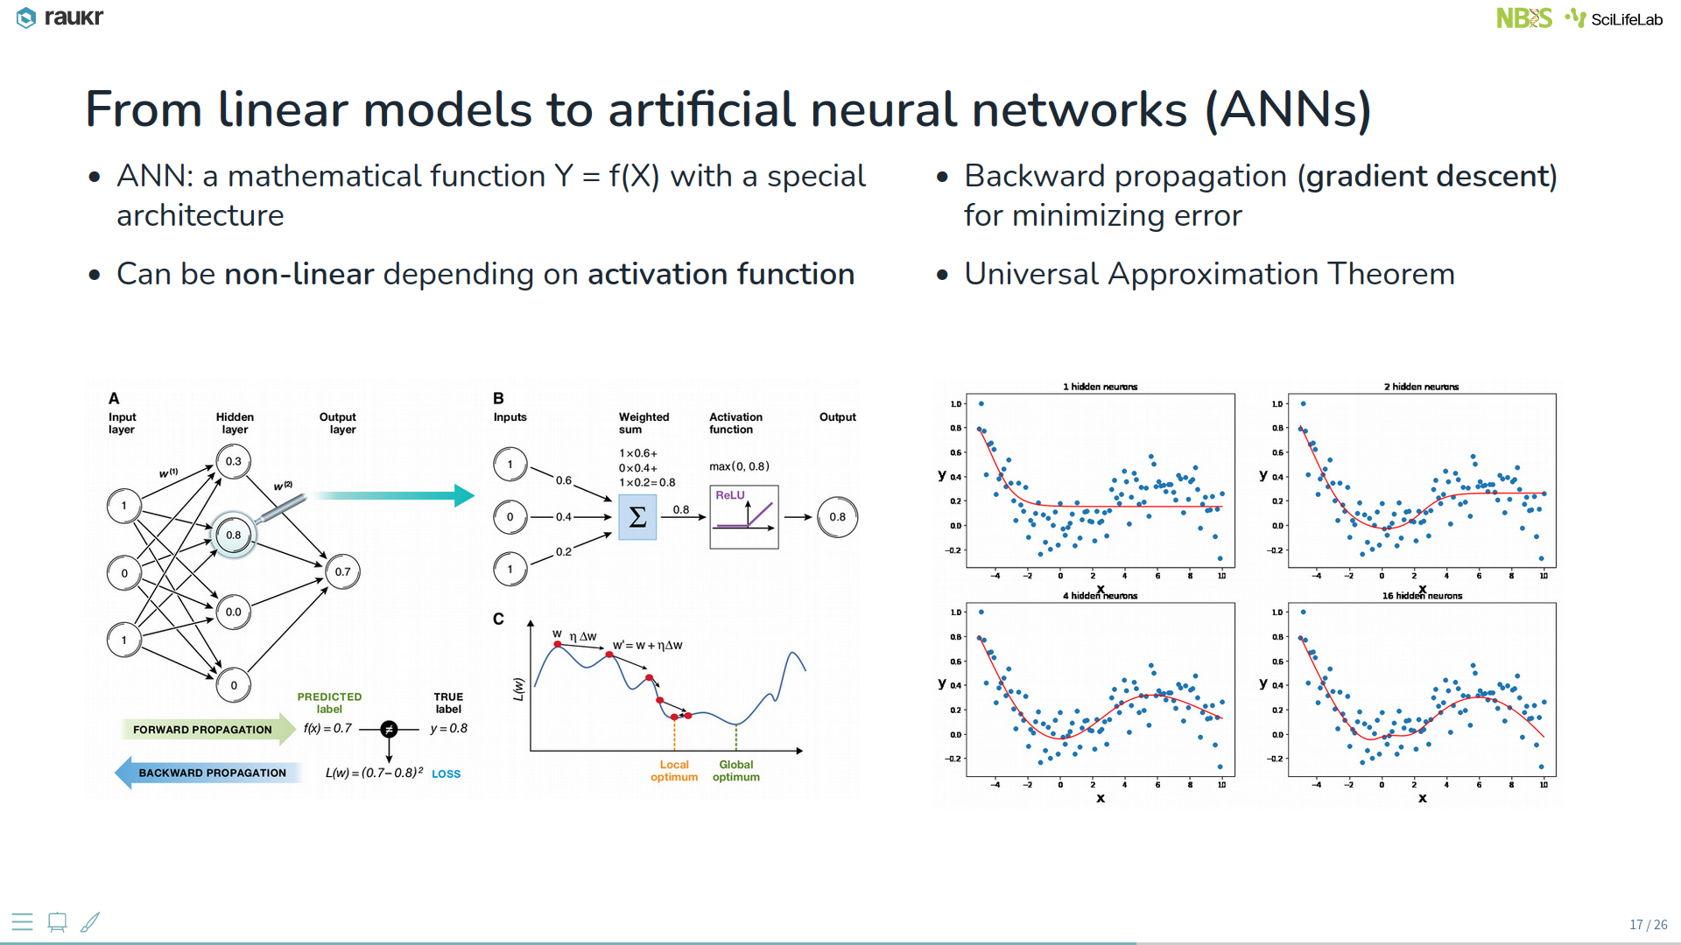
Artificial Neural Networks: general principles

Slide 4
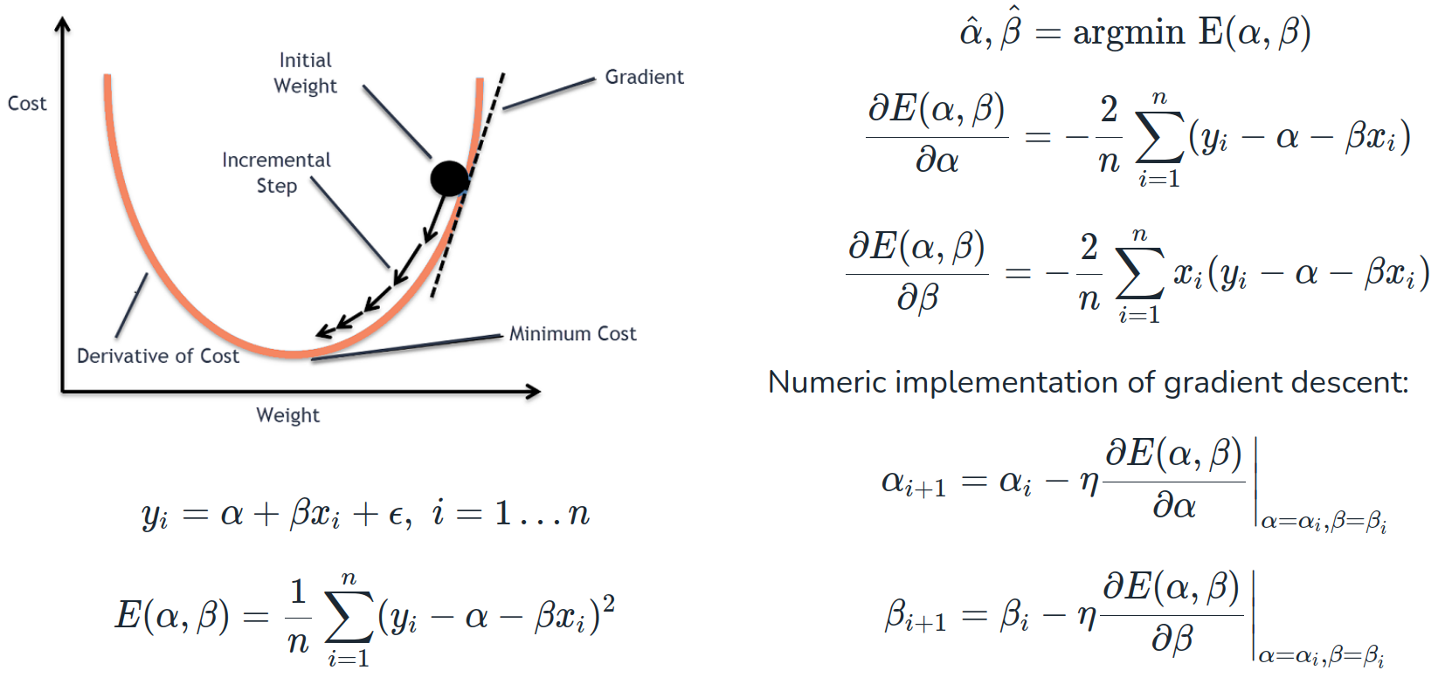
Gradient descent: backward propagation

Slide 5
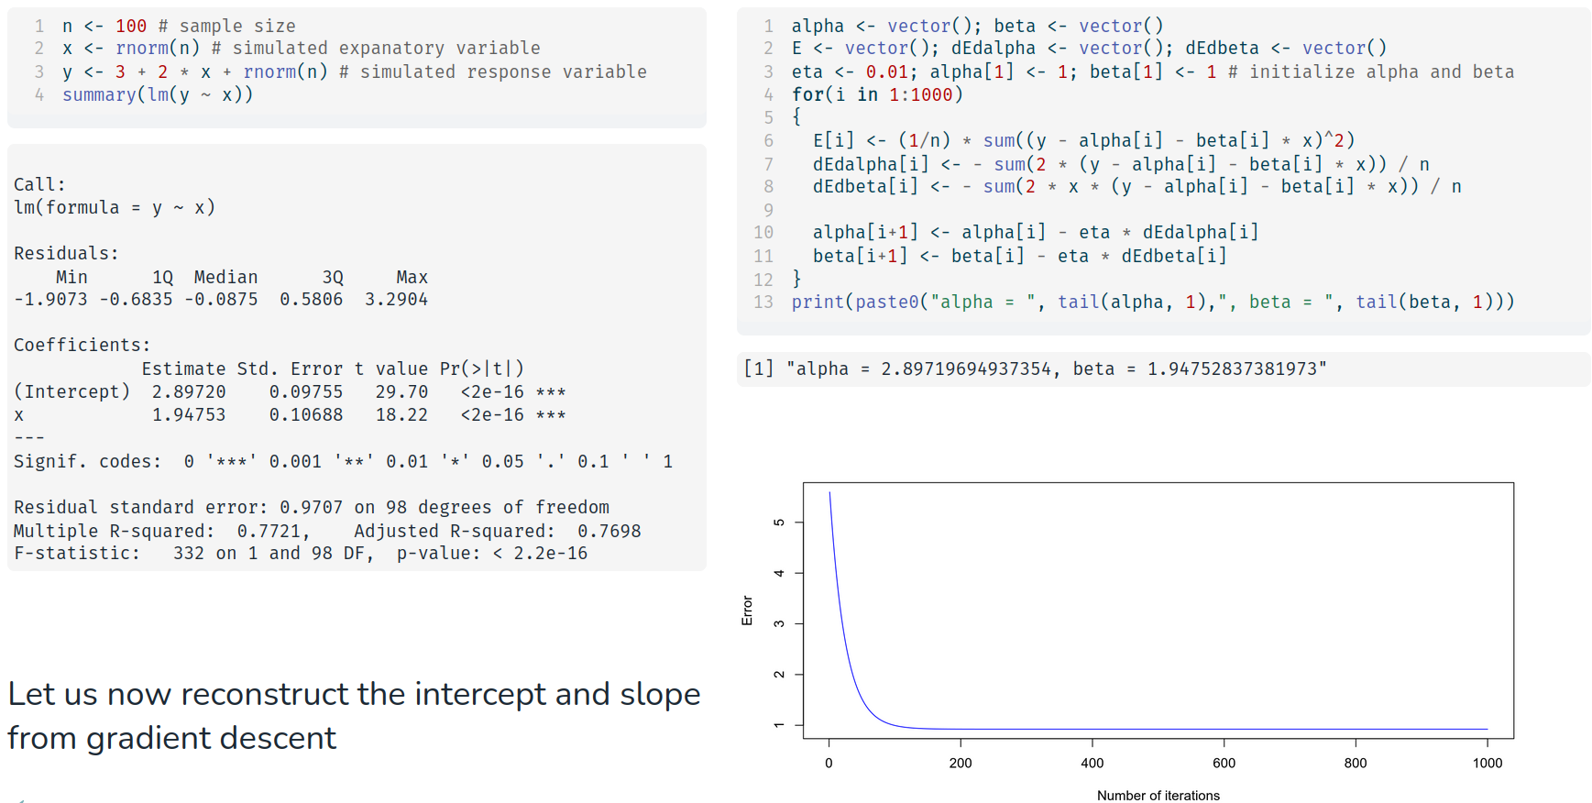
Coding gradient descent from scratch in R

Slide 6
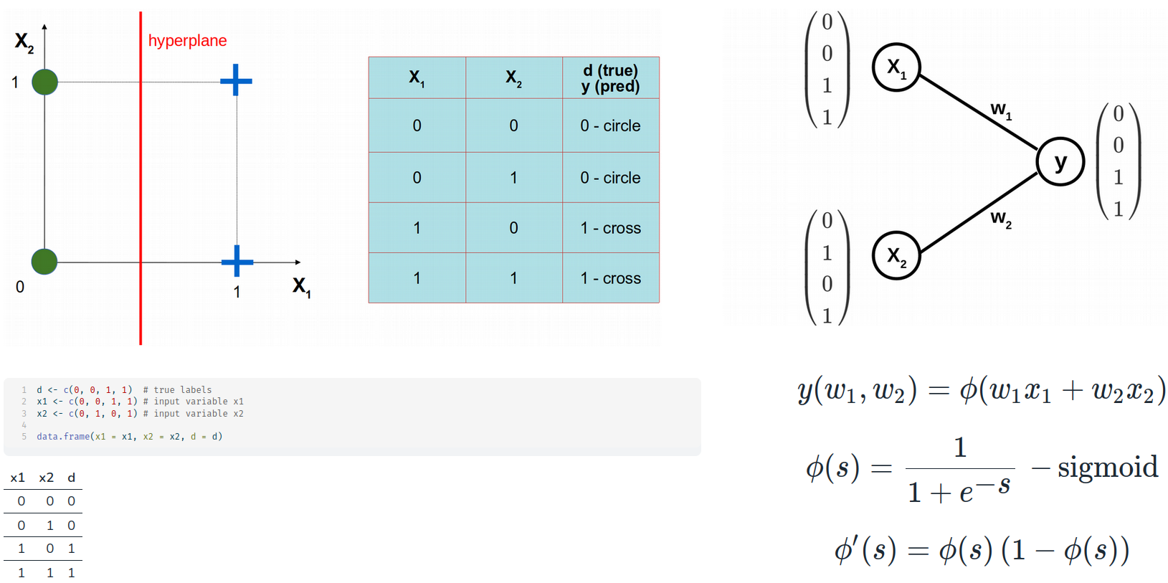
ANN from scratch: problem formulation

Slide 7
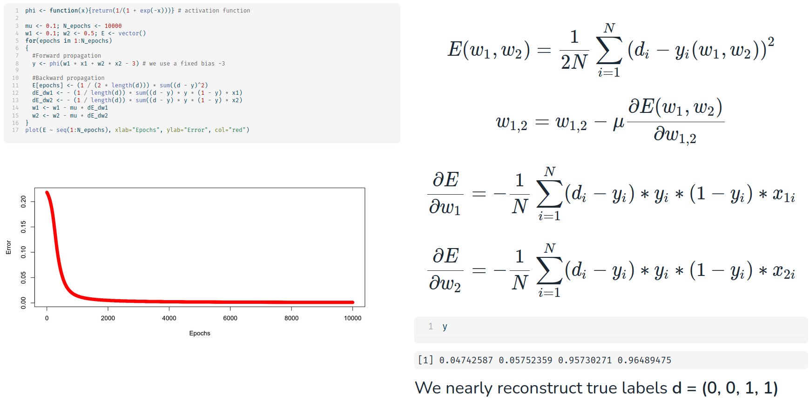
Coding ANN from scratch in R

Slide 8
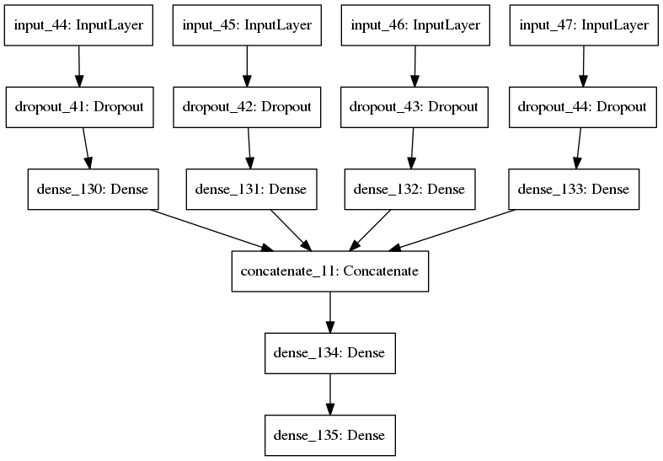
Supervised deep learning Omics integration
OMIC1
OMIC2
OMIC3
OMIC3
Regularization
Conversion to nonparametric space
Integration
Back propagation ensures that all weights are updated in context of each other
Prediction

Slide 9
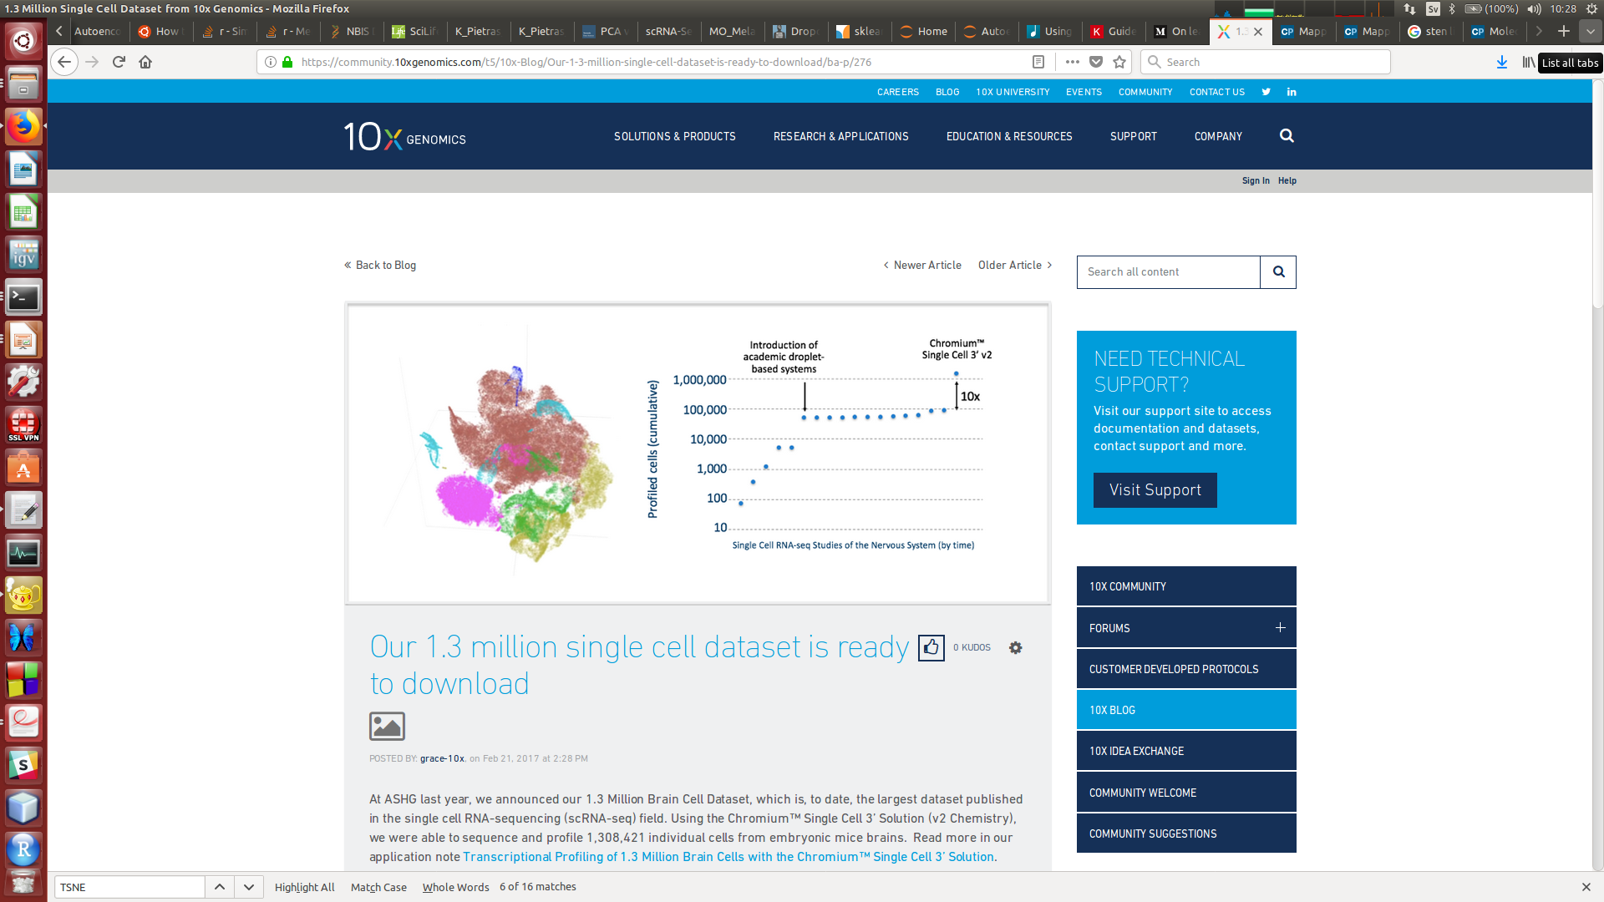
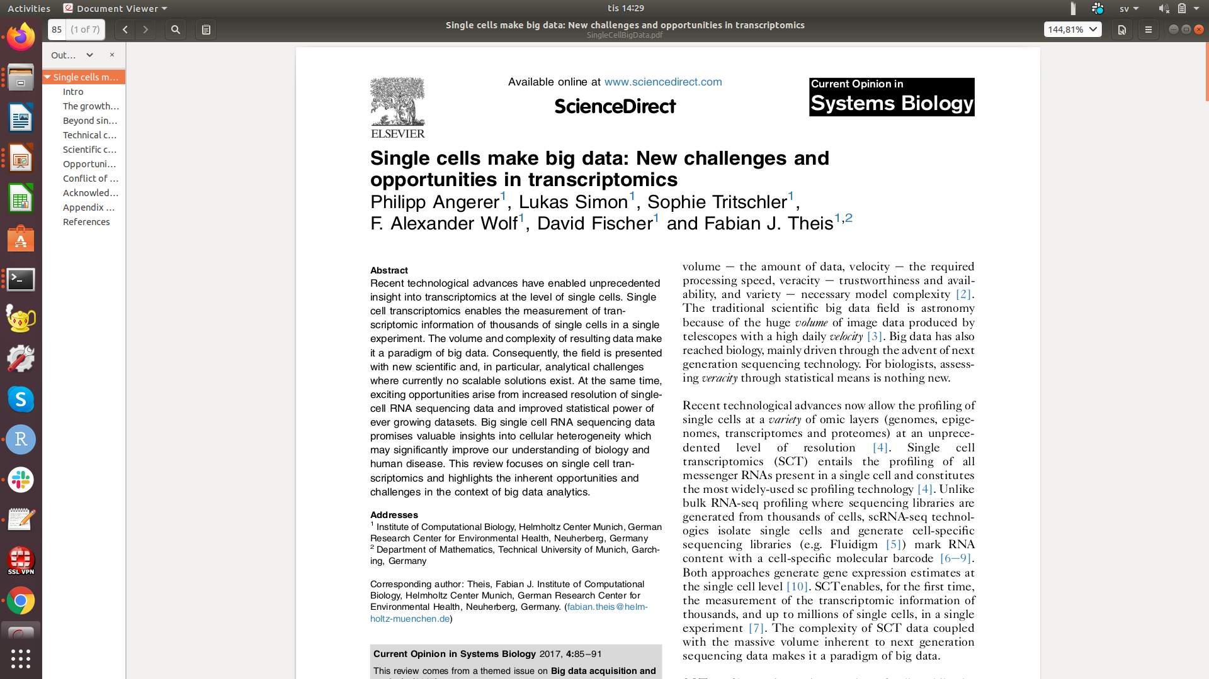
Big Data in single cell genomics

Slide 10
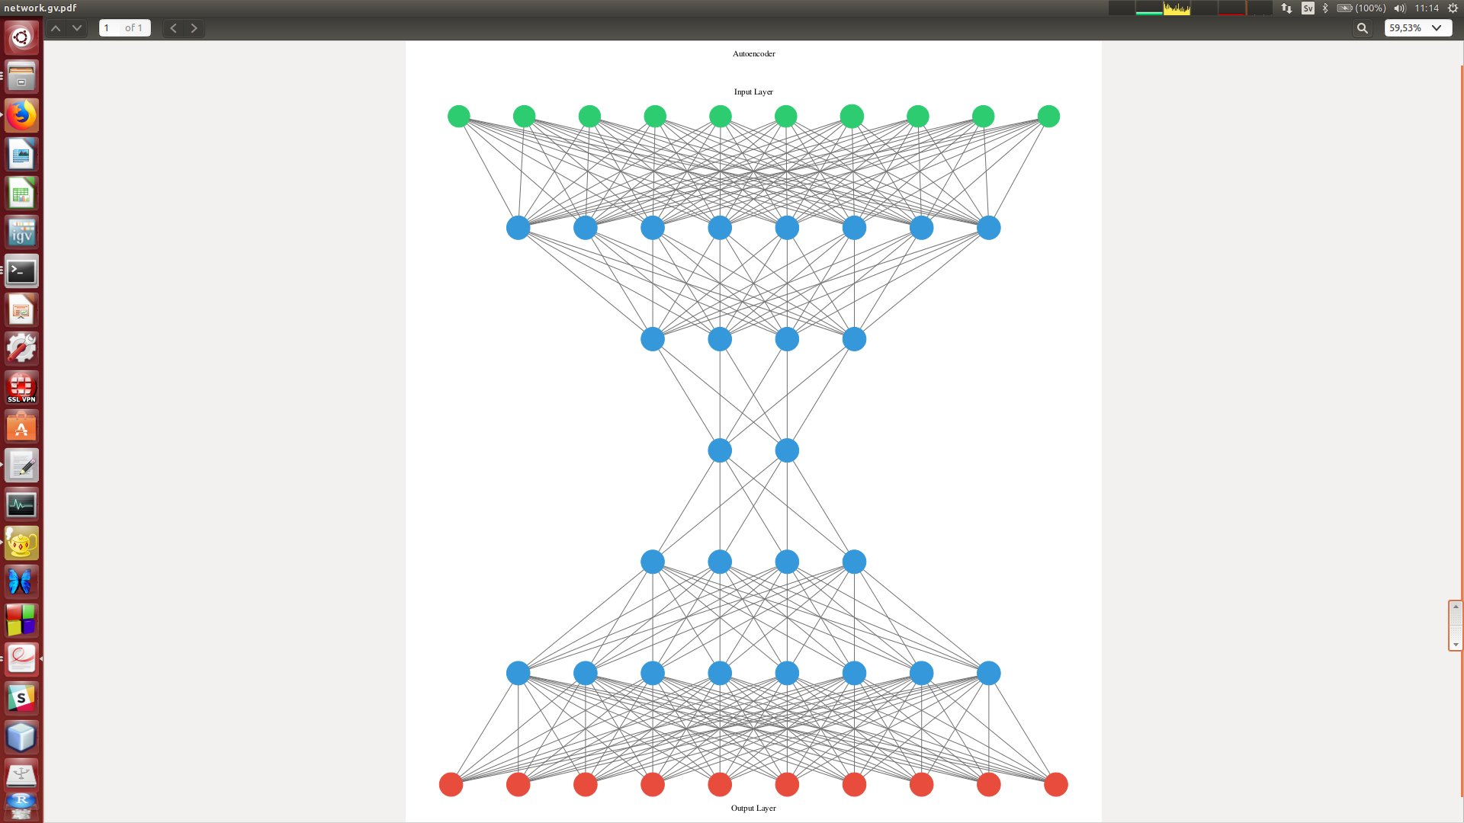
Autoencoder: unsupervised neural network
Encoder
Decoder

Slide 11
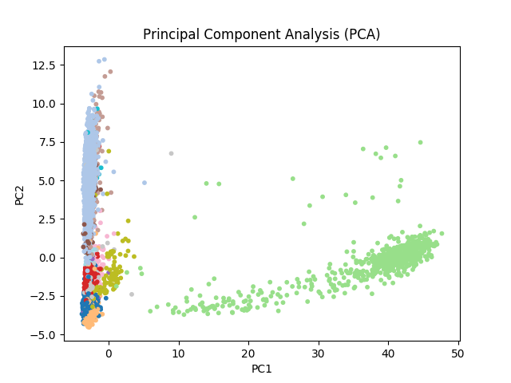
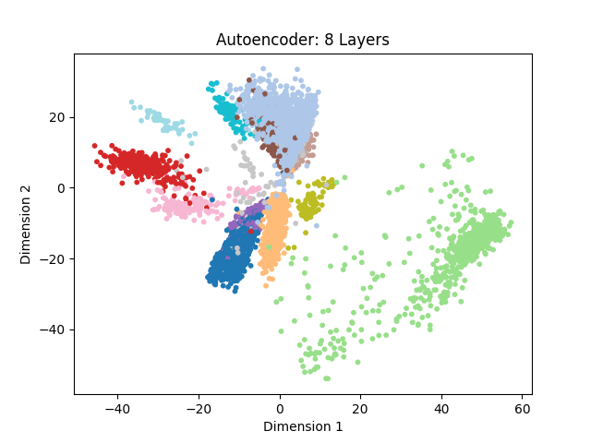
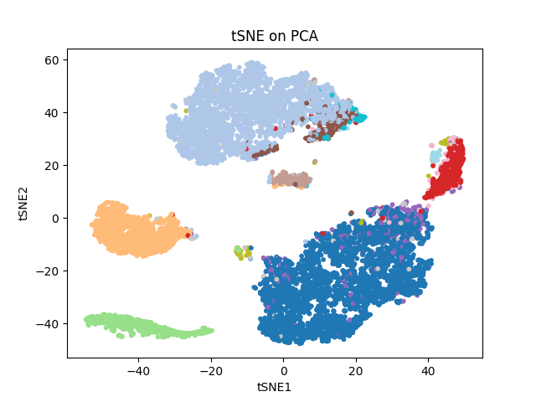
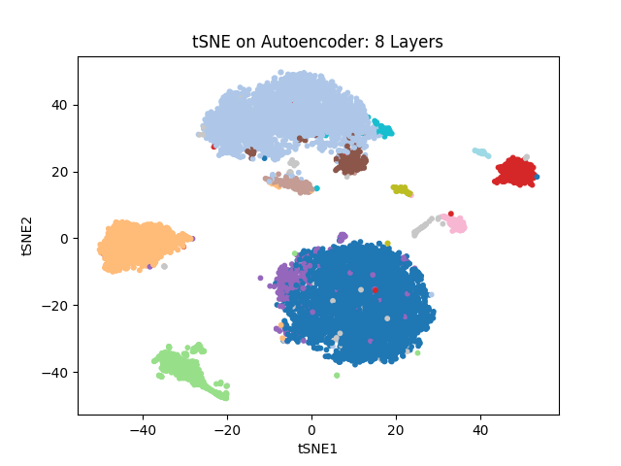
Autoencoder dimension reduction: 8617 PBMC cells
Oskolkov et al., unpublished

Slide 12
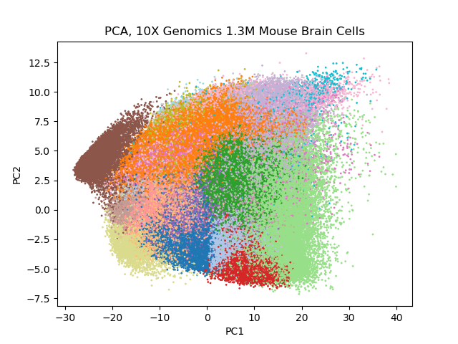
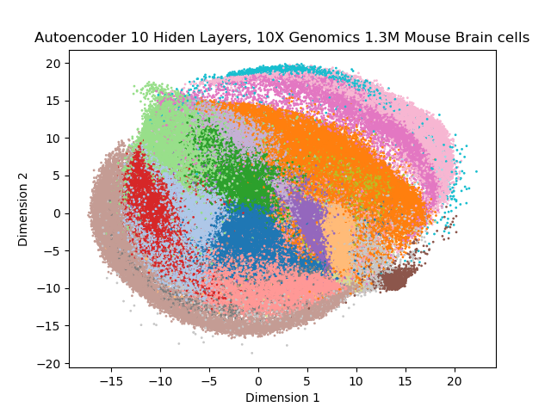
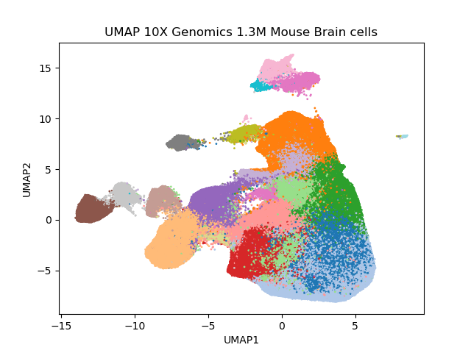
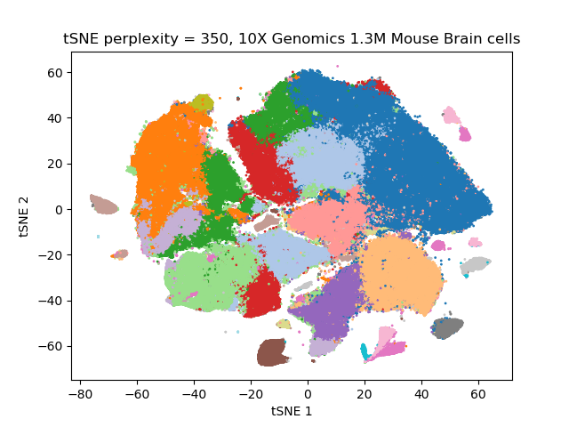
10X Genomics Mouse Brain: scRNAseq, 1.3M cells
Oskolkov et al., unpublished

Slide 13
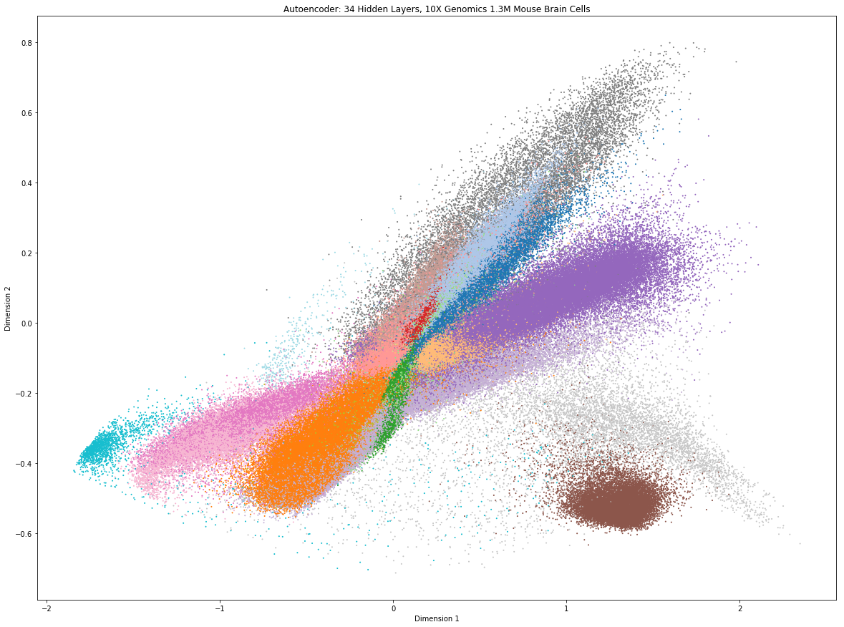
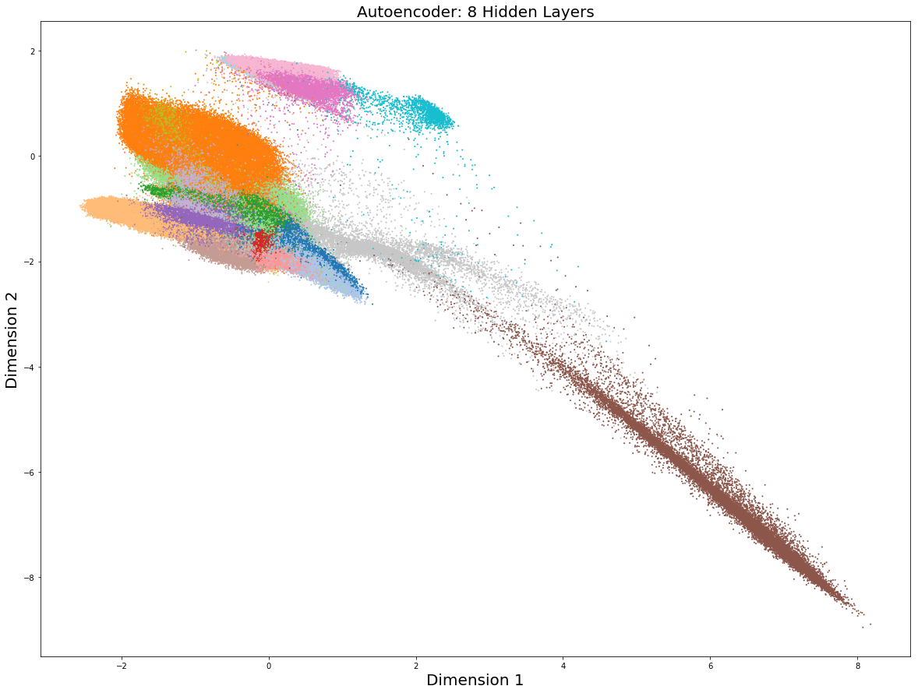
10X Genomics mouse brain: scRNAseq, 1.3M cells
Autoencoders can be promising for non-linear data pre-processing, the bottleneck can potentially be fed to tSNE / UMAP
Autoencoders themselves are perhaps not optimal for visualization of scOmics
Oskolkov et al., unpublished

Slide 14
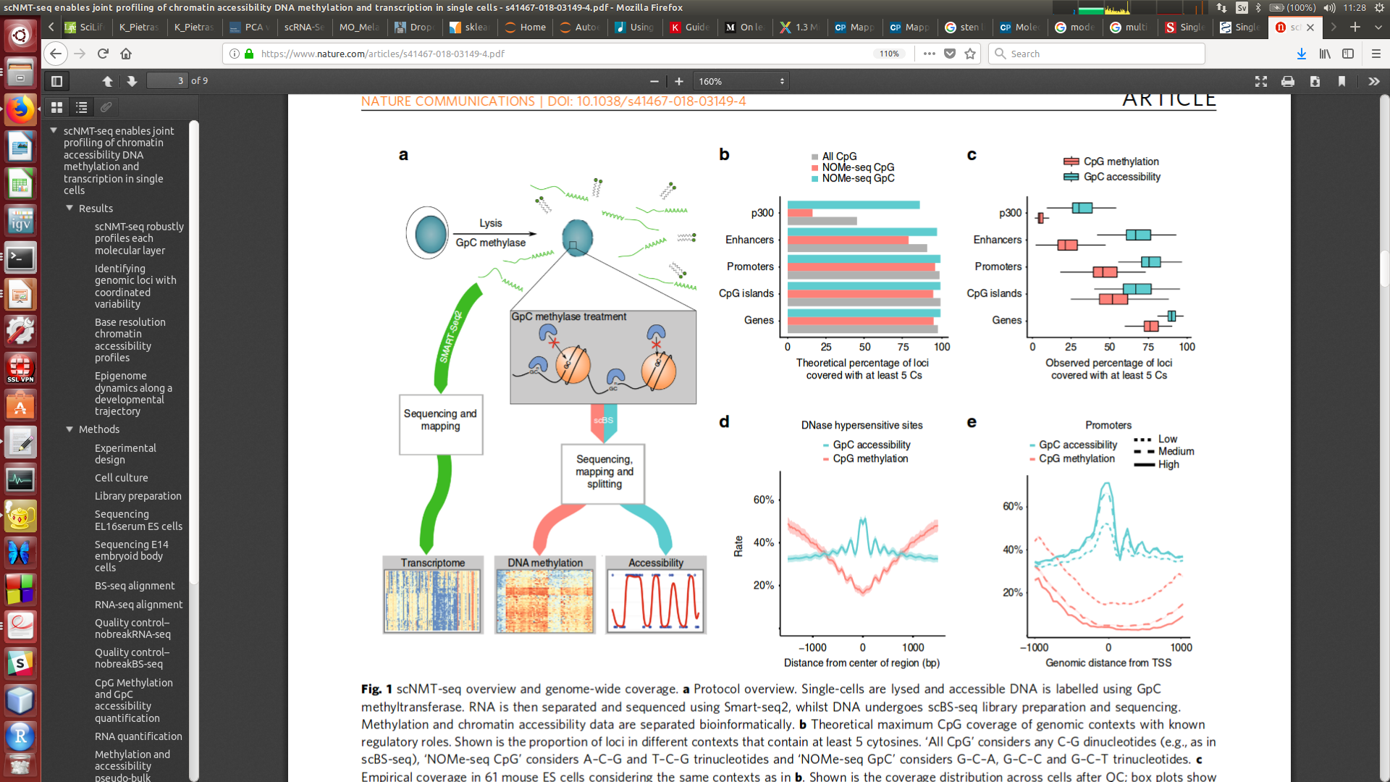
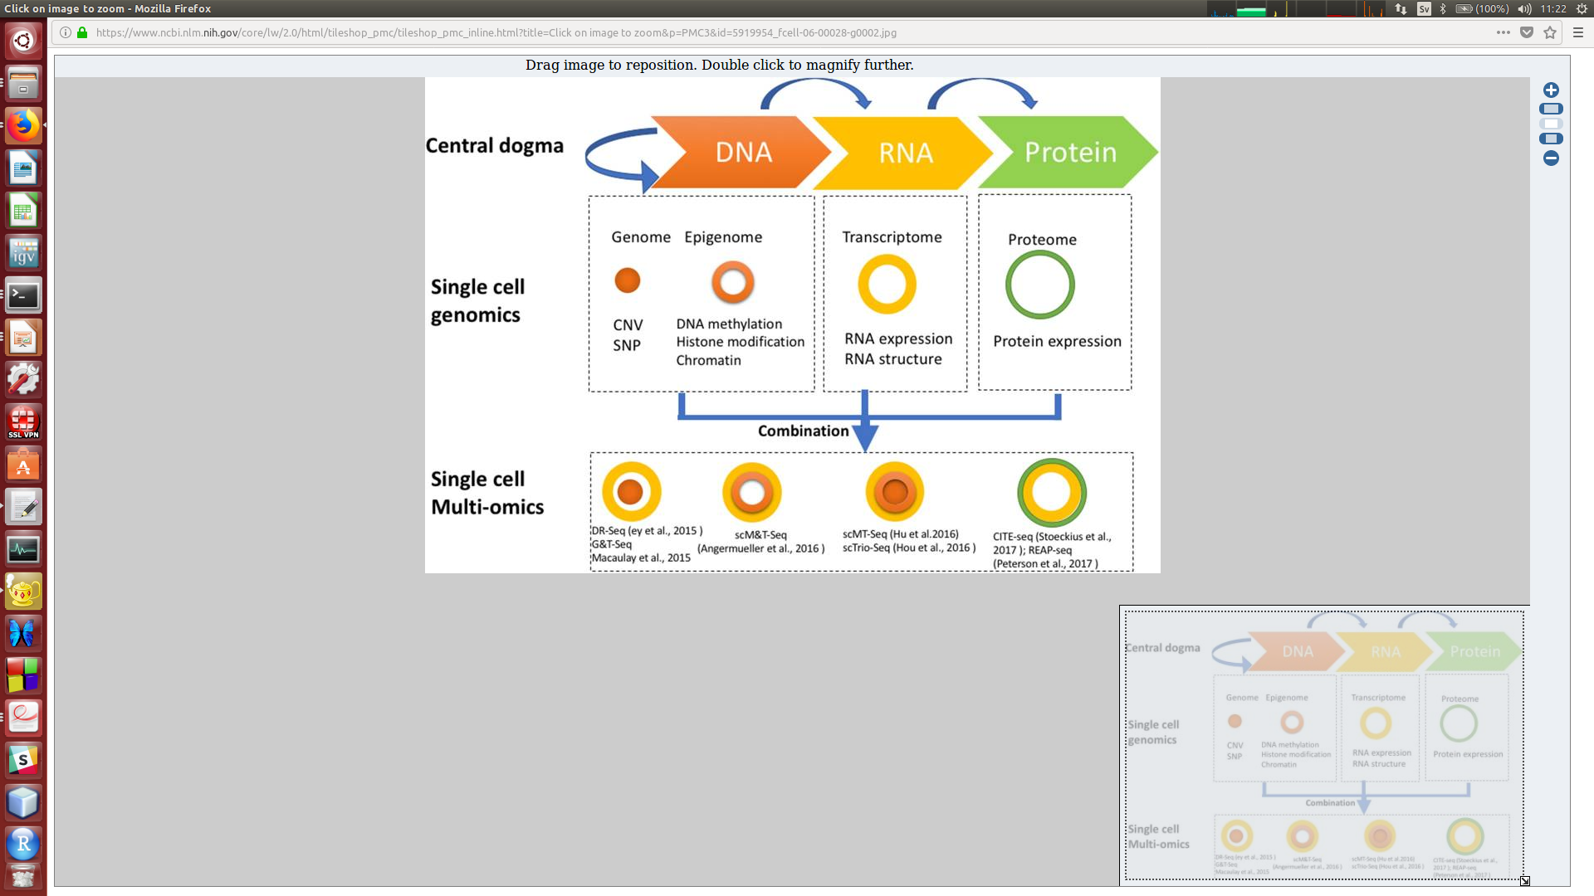
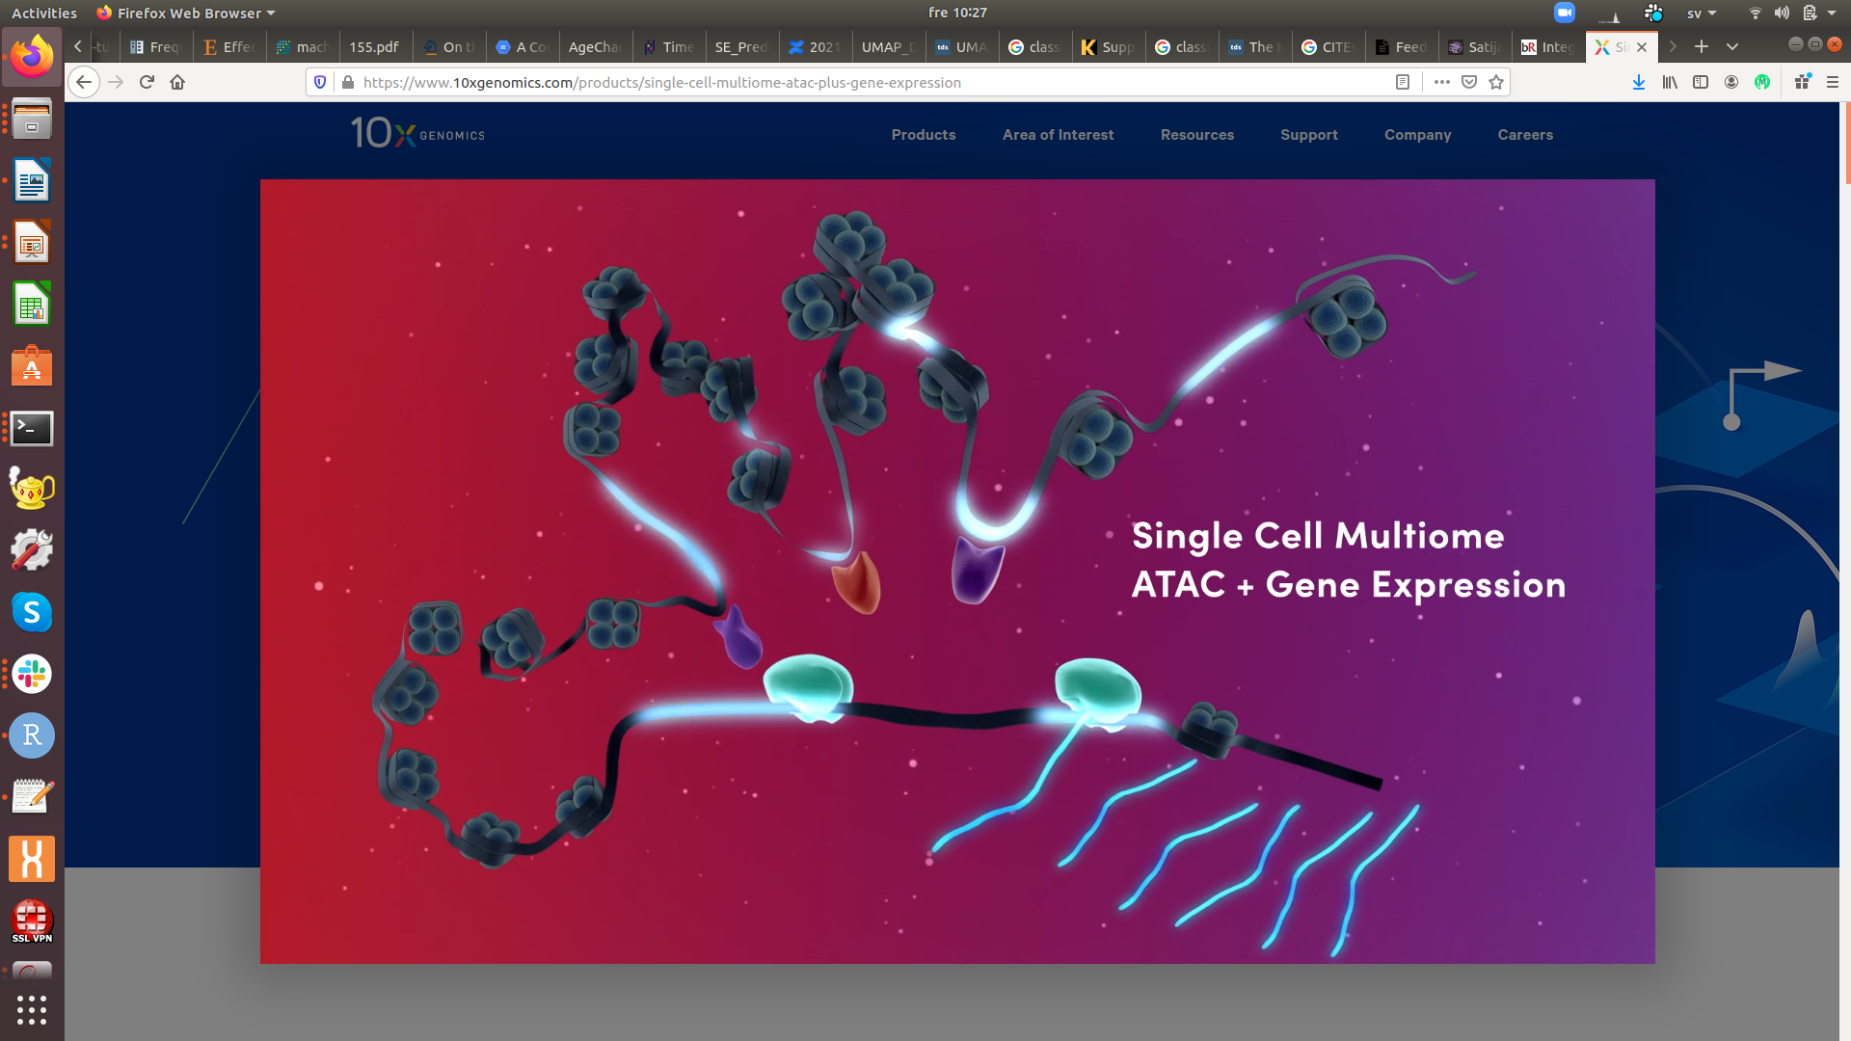
Multi-Omics in Single Cell Genomics
Kelsey et al., 2017, Science 358, 69-75
Clark et al., 2018, Nature Communications 9, 781
Hu et al., 2018, Frontier in Cell and Developmental Biology 6, 1-13

Slide 15
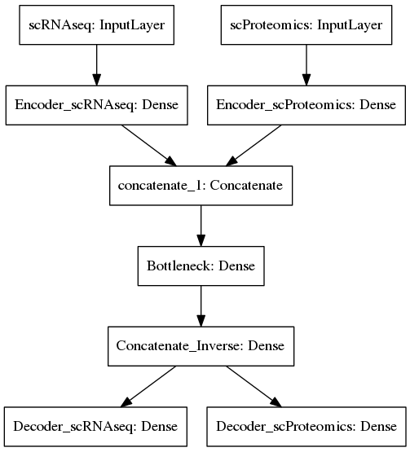
Autoencoder for data integration
Autoencoder: unsupervised neural network
Single Cell analysis is unsupervised
1) Dimensionality Reduction
2) Clustering

Slide 16
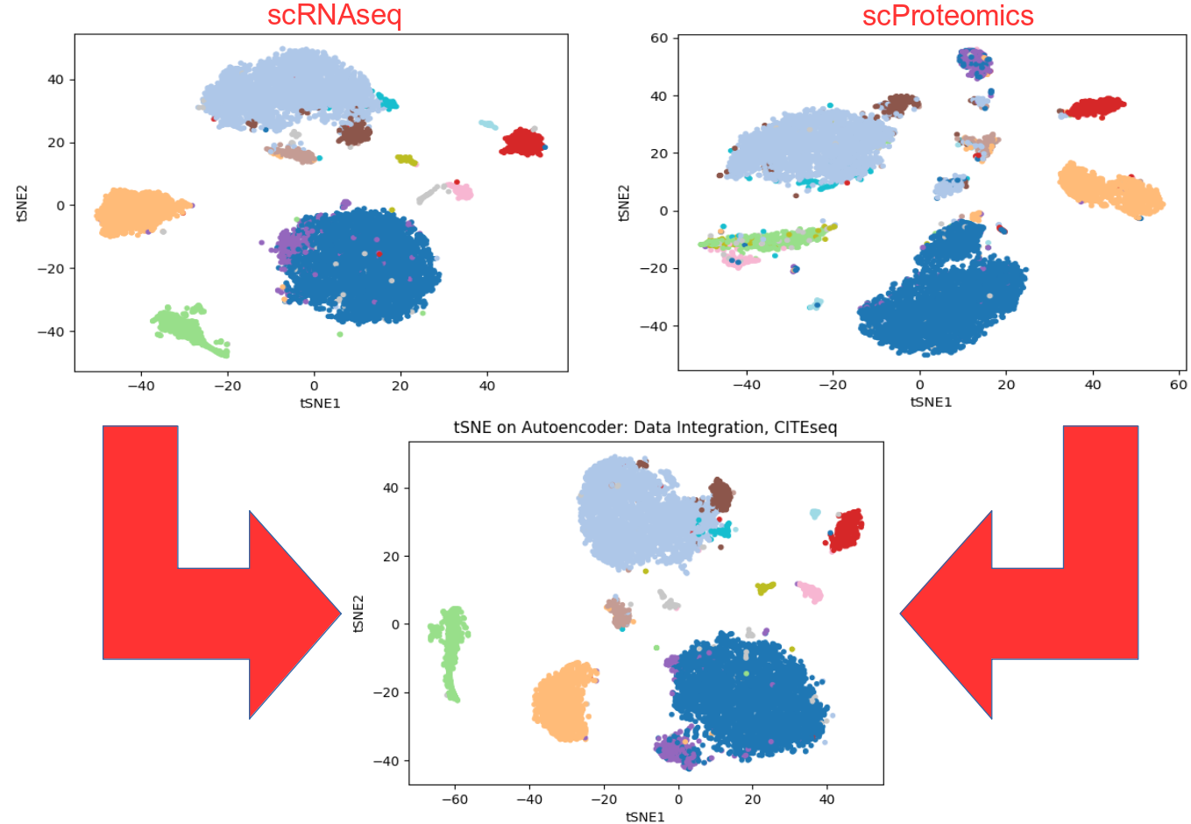
Autoencoder for data integration: CITEseq

Slide 17
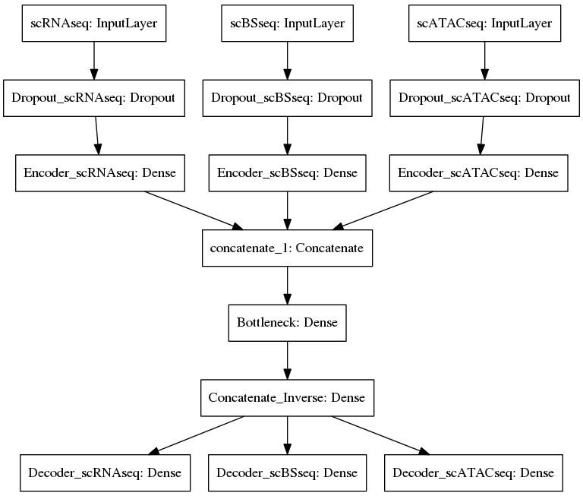
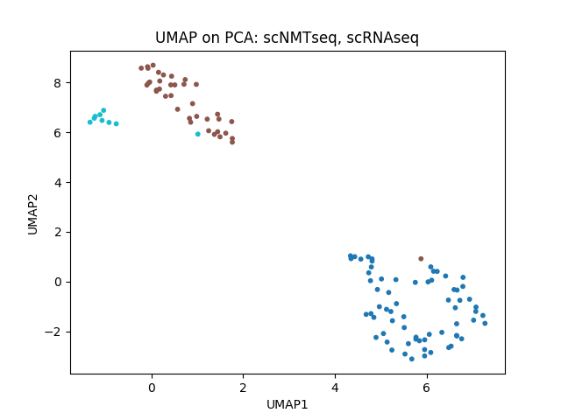
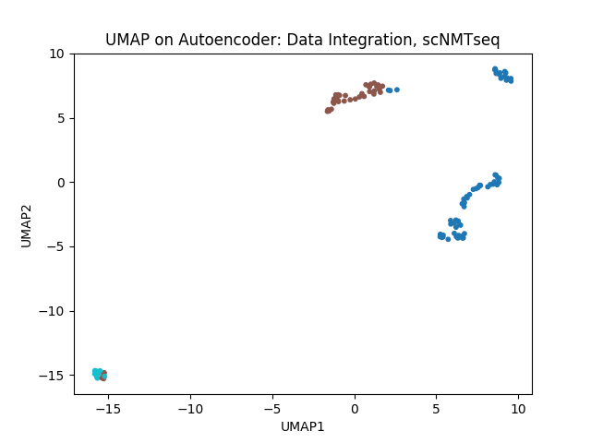
scNMTseq: scRNAseq + scBSseq + scATACseq
scNMTseq: Clark et al., 2018, Nature Communications 9, 781
From Single To
multi-Omics

Slide 18
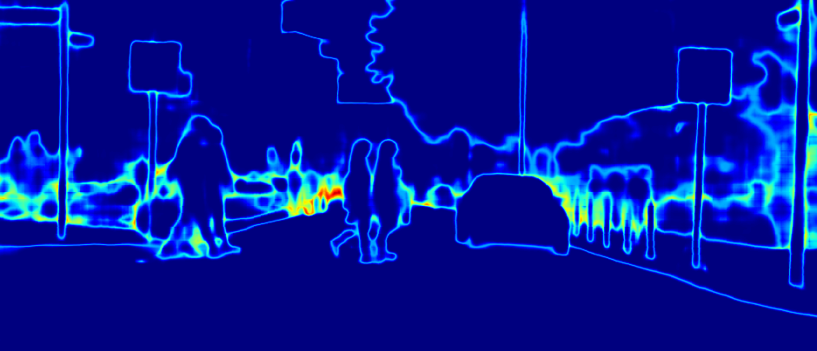
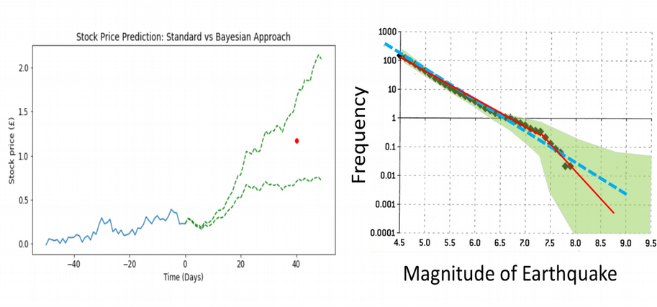

When Deep Learning is not good enough
Intelligence is to know how much you do not know

Slide 19
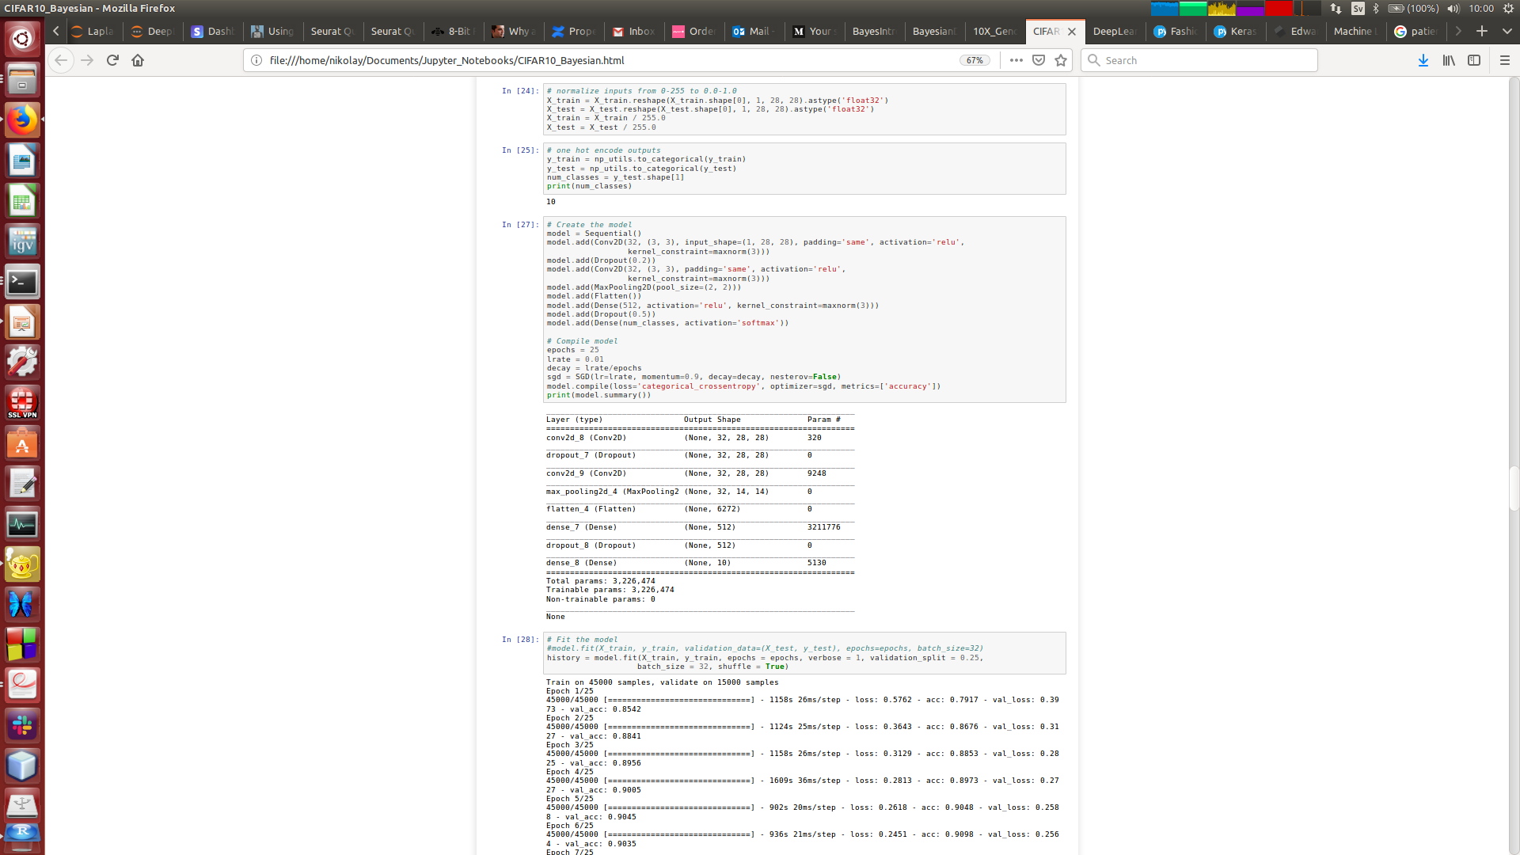
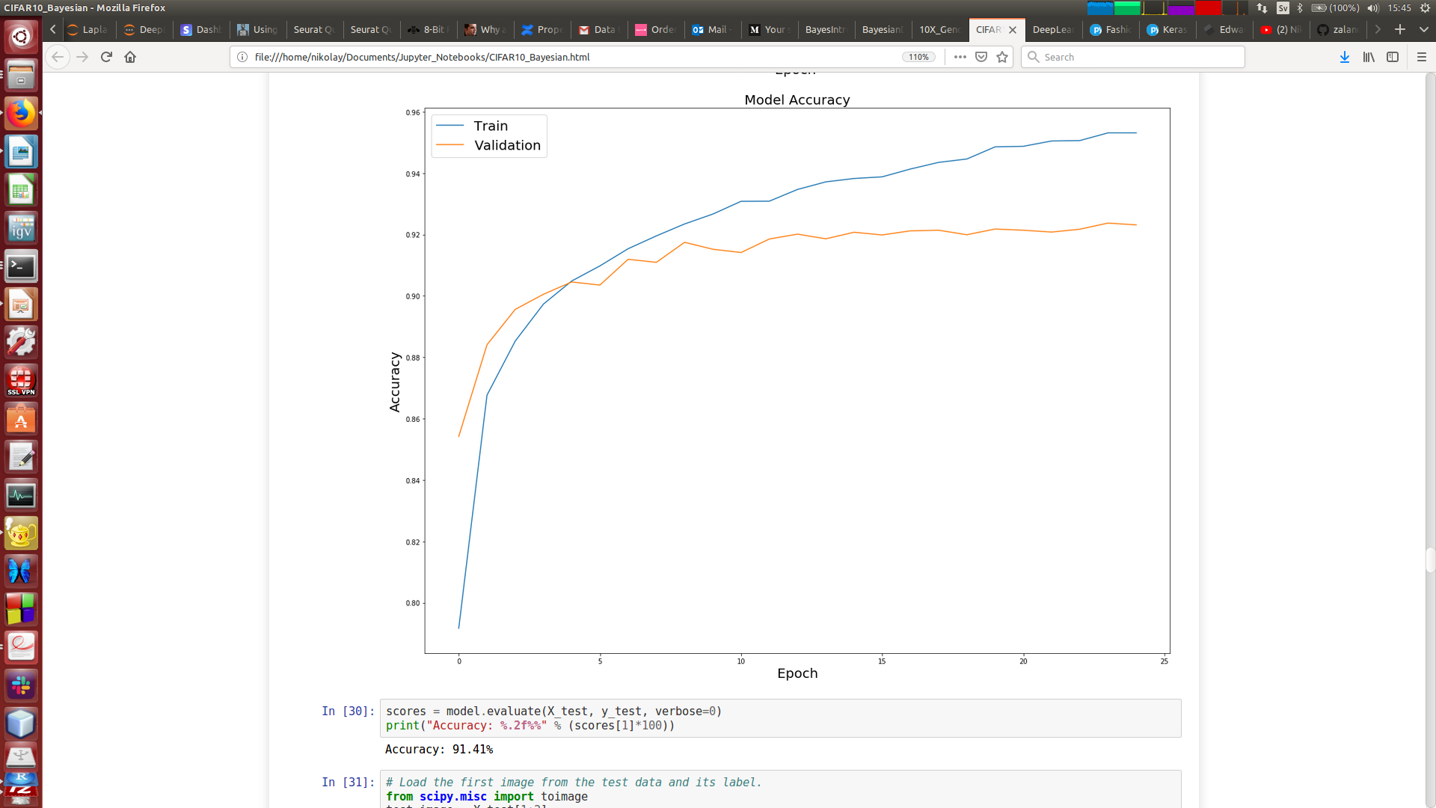
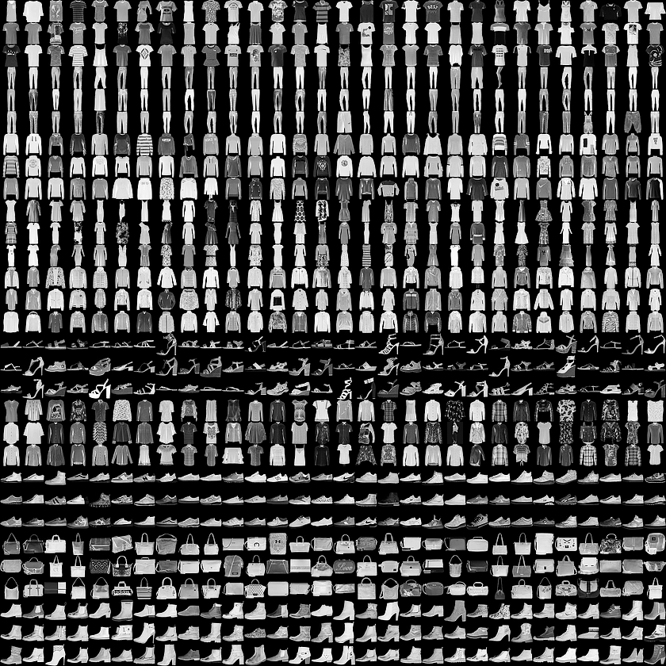
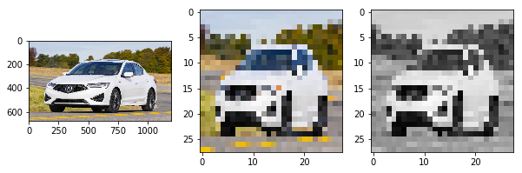
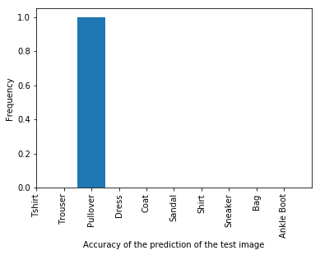
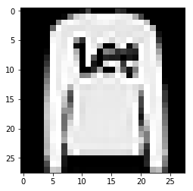
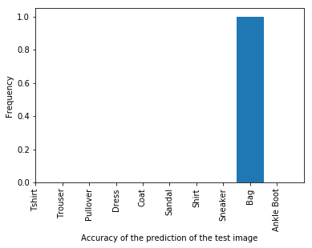
Frequentist image recognition
Fashion MNIST
Prediction

Slide 20
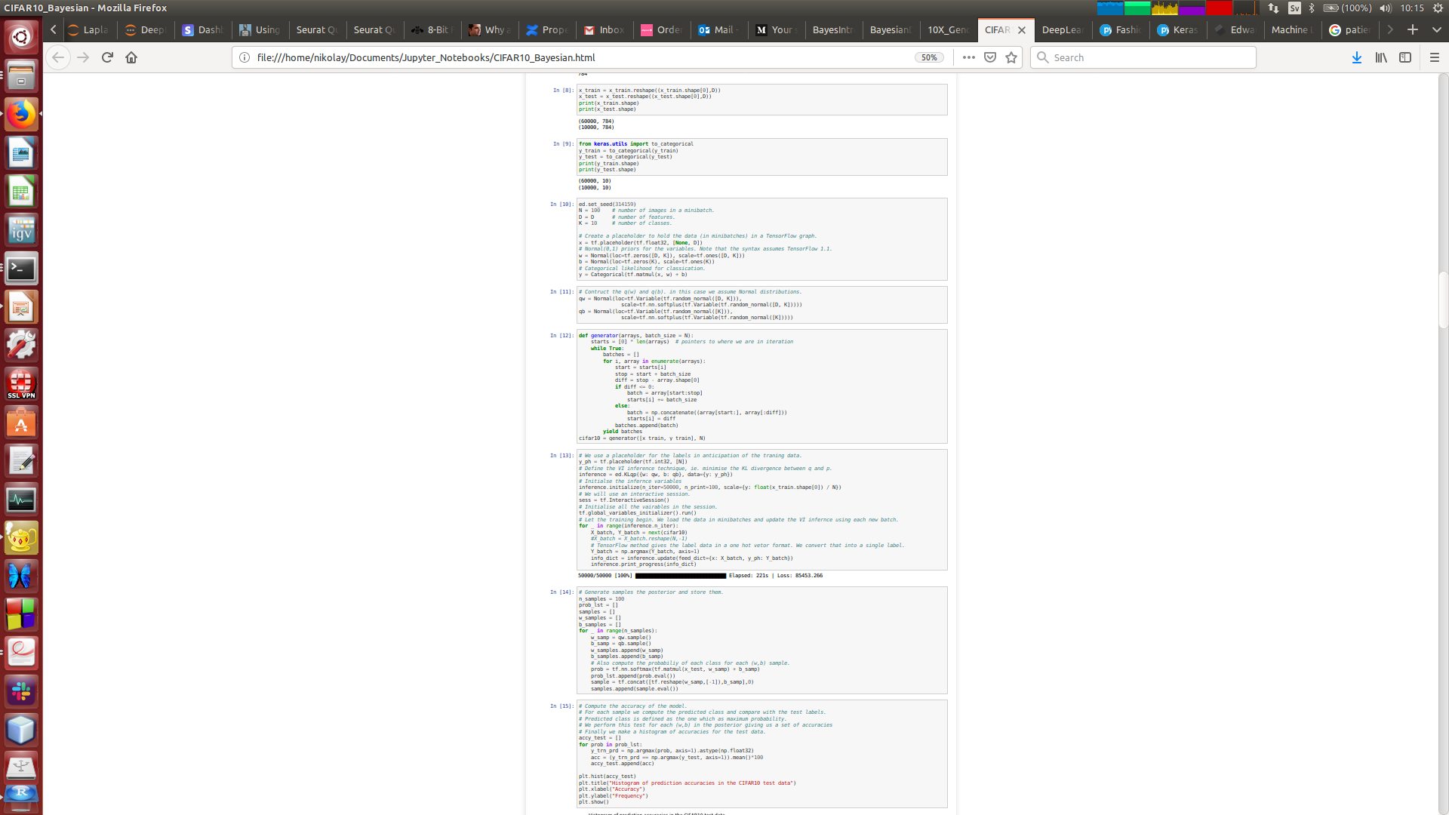
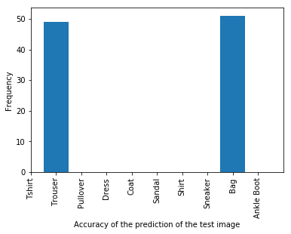
Bayesian image recognition
PyMC3, Edward, TensorFlow Probability
Prediction

Slide 21
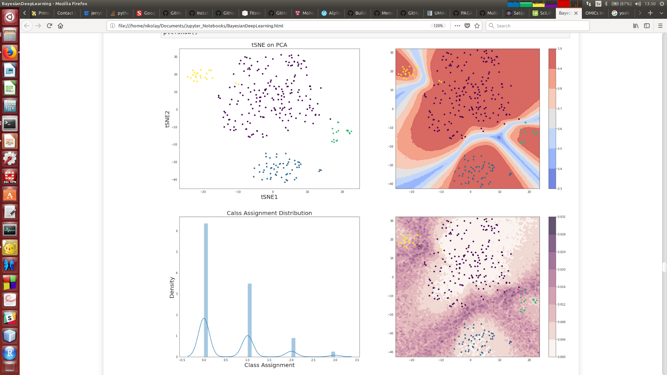


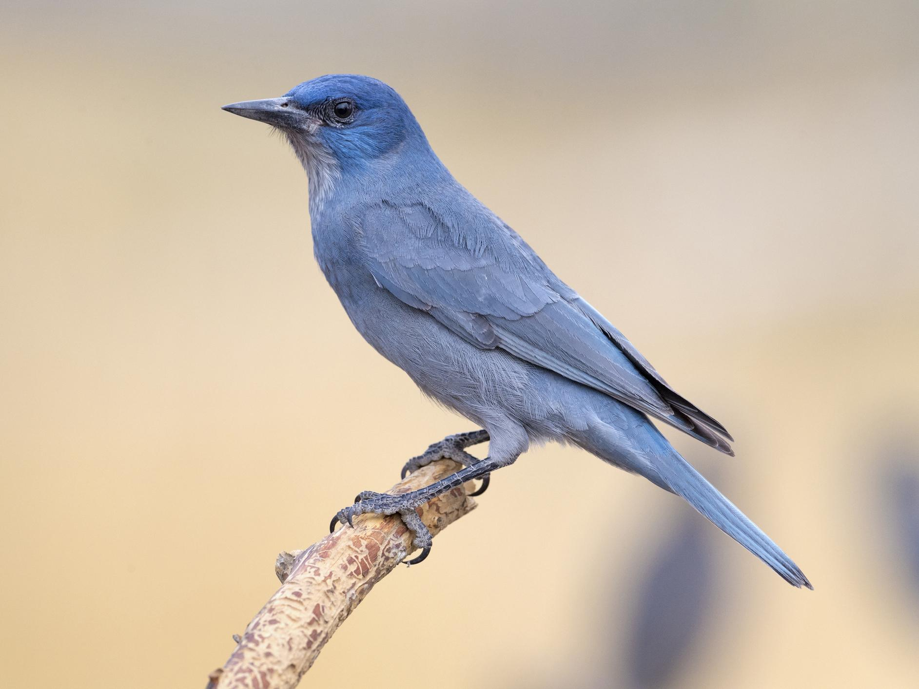

Bayesian deep learning for single cell
Bartoschek, Oskolkov et al., Nature Communications 2018
1) handy for unseen (during training) data, 2) uncertainties are crucial for clinical diagnostics

Slide 22
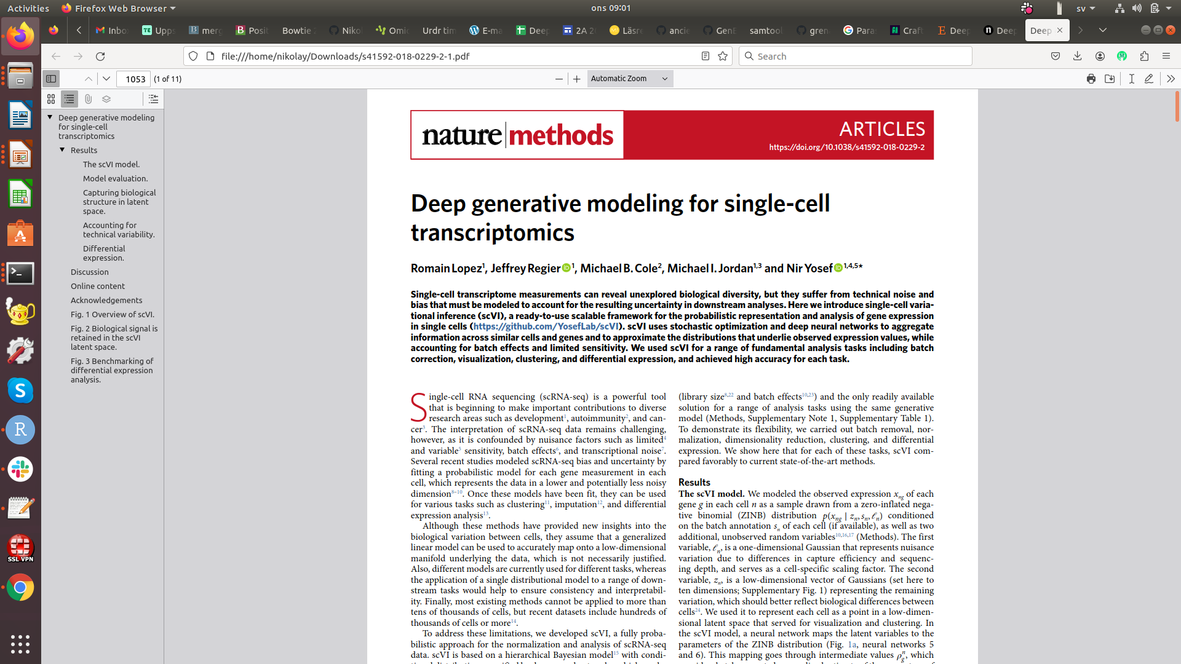
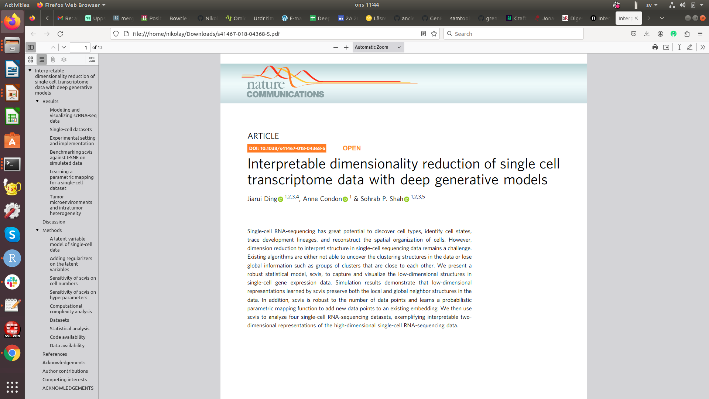
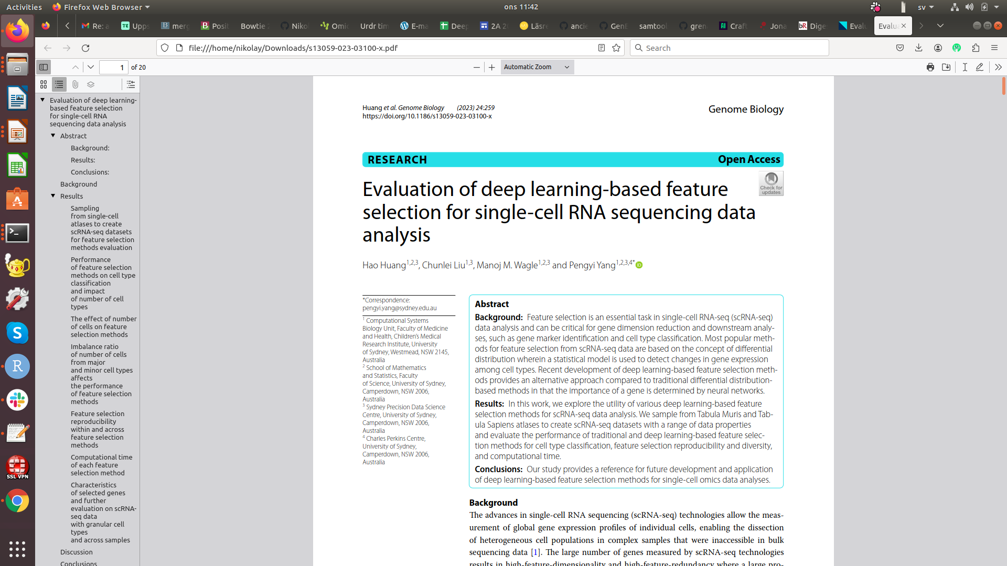
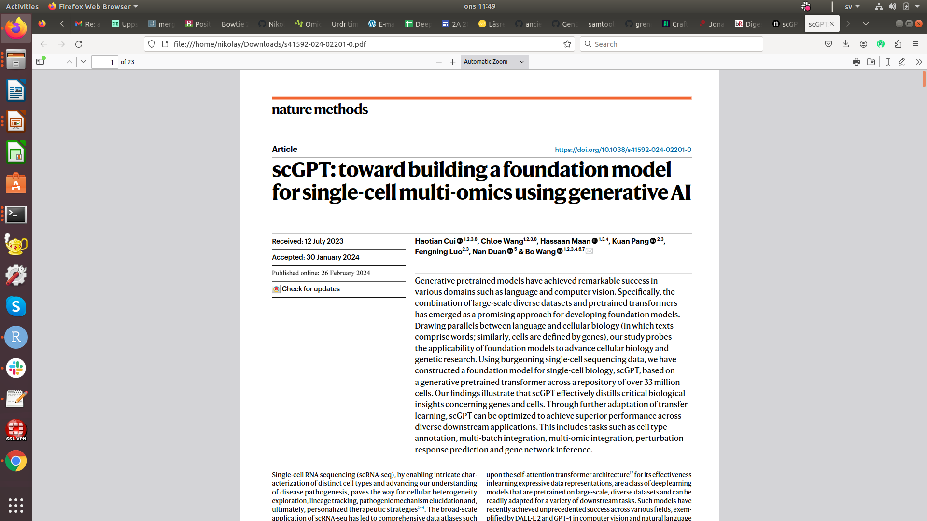
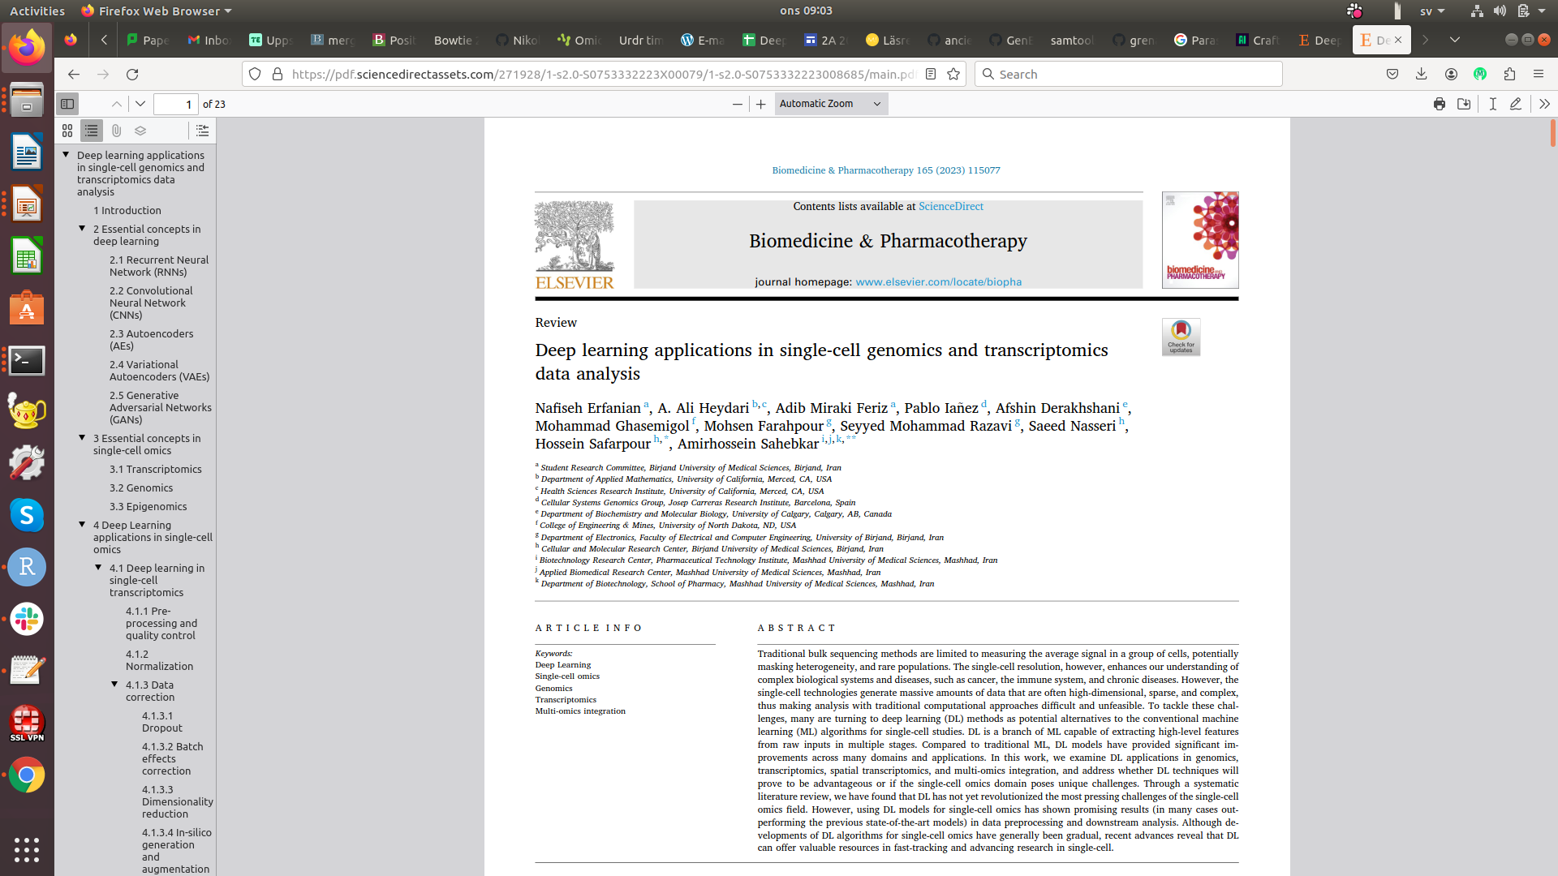
AI applications for single cell biology

Slide 23
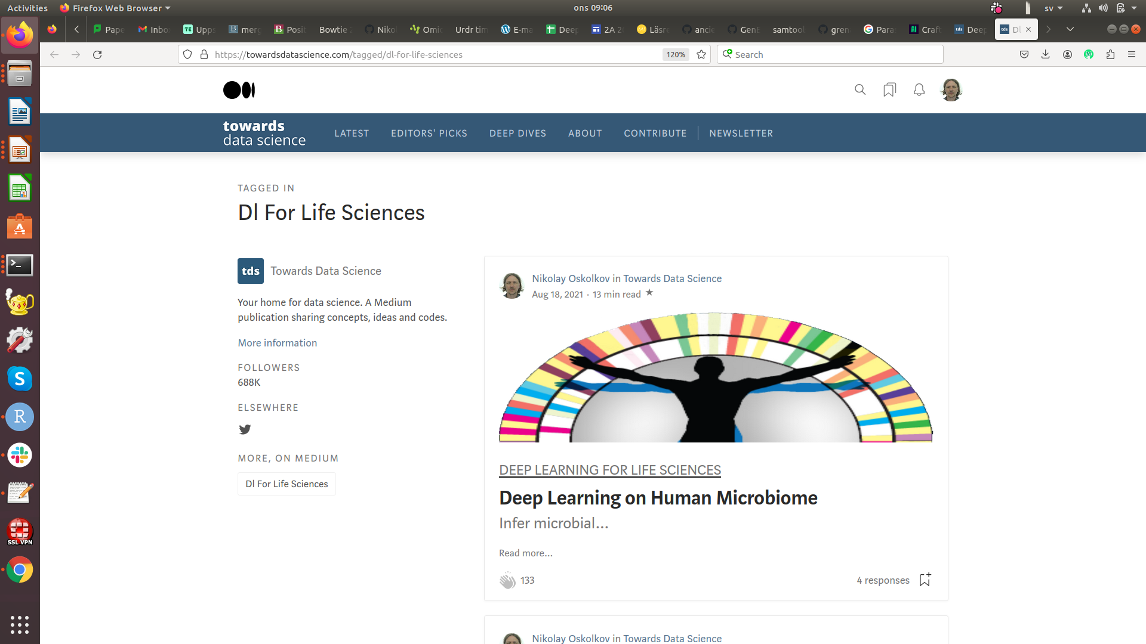
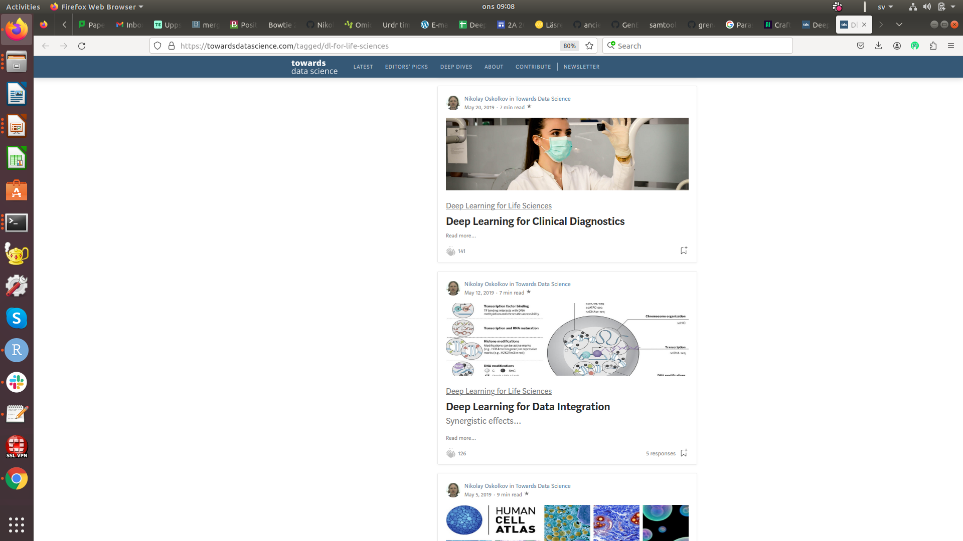


Popular summary of AI for Life Sciences

Slide 24




National Bioinformatics Infrastructure Sweden (NBIS)

